Slide 1

Chapter 12 :: Concurrency
Programming Language Pragmatics
Michael L. Scott
Copyright © 2009 Elsevier

Slide 2
Background and Motivation
A PROCESS or THREAD is a potentially-active execution context
Classic von Neumann (stored program) model of computing has single thread of control
Parallel programs have more than one
A process can be thought of as an abstraction of a physical PROCESSOR
Copyright © 2009 Elsevier

Slide 3
Background and Motivation
Processes/Threads can come from
  multiple CPUs
  kernel-level multiplexing of single physical machine
  language or library level multiplexing of kernel-level abstraction
They can run
  in true parallel
  unpredictably interleaved
  run-until-block
Most work focuses on the first two cases, which are equally difficult to deal with
Copyright © 2009 Elsevier

Slide 4
Background and Motivation
Two main classes of programming notation
  synchronized access to shared memory
  message passing between processes that don't share memory
Both approaches can be implemented on hardware designed for the other, though shared memory on message-passing hardware tends to be slow
Copyright © 2009 Elsevier

Slide 5
Background and Motivation
Race conditions
  A race condition occurs when actions in two processes are not synchronized and program behavior depends on the order in which the actions happen
  Race conditions are not all bad; sometimes any of the possible program outcomes are ok (e.g. workers taking things off a task queue)
Copyright © 2009 Elsevier

Slide 6
Background and Motivation
Race conditions (we want to avoid race conditions):
  Suppose processors A and B share memory, and both try to increment variable X at more or less the same time
  Very few processors support arithmetic operations on memory, so each processor executes
      LOAD X
      INC
      STORE X
  Suppose X is initialized to 0. If both processors execute these instructions simultaneously, what are the possible outcomes?
    could go up by one or by two
Copyright © 2009 Elsevier

Slide 7
Background and Motivation
Synchronization
  SYNCHRONIZATION is the act of ensuring that events in different processes happen in a desired order
  Synchronization can be used to eliminate race conditions
  In our example we need to synchronize the increment operations to enforce MUTUAL EXCLUSION on access to X
  Most synchronization can be regarded as either
    Mutual exclusion (making sure that only one process is executing a CRITICAL SECTION [touching a variable, for example] at a time),
    or as
    CONDITION SYNCHRONIZATION, which means making sure that a given process does not proceed until some condition holds (e.g. that a variable contains a given value)
Copyright © 2009 Elsevier

Slide 8
Background and Motivation
One might be tempted to think of mutual exclusion as a form of condition synchronization (the condition being that nobody else is in the critical section), but it isn't
  The distinction is basically existential v. universal quantification
    Mutual exclusion requires multi-process consensus
We do NOT in general want to over-synchronize
  That eliminates parallelism, which we generally want to encourage for performance
Basically, we want to eliminate "bad" race conditions, i.e., the ones that cause the program to give incorrect results
Copyright © 2009 Elsevier

Slide 9
Background and Motivation
Historical development of shared memory ideas
  To implement synchronization you have to have something that is ATOMIC
    that means it happens all at once, as an indivisible action
    In most machines, reads and writes of individual memory locations are atomic (note that this is not trivial; memory and/or busses must be designed to arbitrate and serialize concurrent accesses)
    In early machines, reads and writes of individual memory locations were all that was atomic
  To simplify the implementation of mutual exclusion, hardware designers began in the late 60's to build so-called read-modify-write, or fetch-and-phi, instructions into their machines
Copyright © 2009 Elsevier

Slide 10
Concurrent Programming Fundamentals
SCHEDULERS give us the ability to "put a thread/process to sleep" and run something else on its process/processor
  start with coroutines
  make uniprocessor run-until-block threads
  add preemption
  add multiple processors
Copyright © 2009 Elsevier

Slide 11
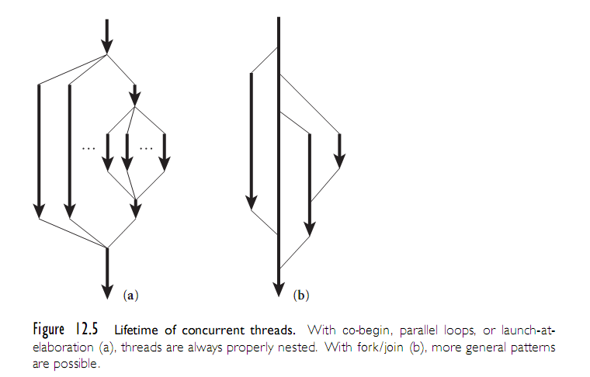
Concurrent Programming Fundamentals
Copyright © 2009 Elsevier

Slide 12
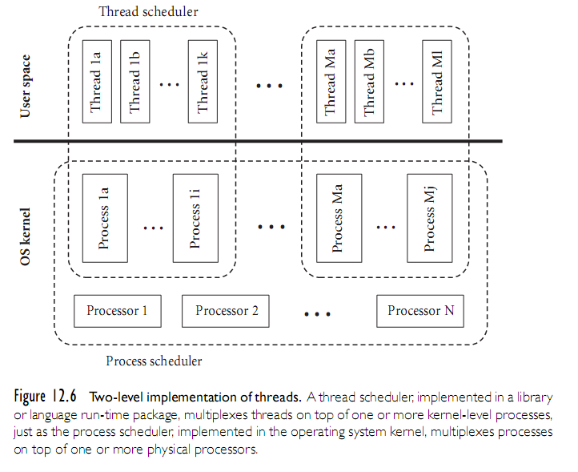
Concurrent Programming Fundamentals
Copyright © 2009 Elsevier

Slide 13
Concurrent Programming Fundamentals
Coroutines
  Multiple execution contexts, only one of which is active
  Transfer (other):
    save all callee-saves registers on stack, including ra and fp
    *current := sp
    current := other
    sp := *current
    pop all callee-saves registers (including ra, but NOT sp!)
    return (into different coroutine!)
  Other and current are pointers to CONTEXT BLOCKs
    Contains sp; may contain other stuff as well (priority, I/O status, etc.)
  No need to change PC; always changes at the same place
  Create new coroutine in a state that looks like it's blocked in transfer. (Or maybe let it execute and then "detach". That's basically early reply)
Copyright © 2009 Elsevier

Slide 14
Concurrent Programming Fundamentals
Run-until block threads on a single process
  Need to get rid of explicit argument to transfer
  Ready list data structure: threads that are runnable but not running
      procedure reschedule:
        t : cb := dequeue(ready_list)
        transfer(t)
  To do this safely, we need to save 'current' somewhere - two ways to do this:
    Suppose we're just relinquishing the processor for the sake of fairness (as in MacOS or Windows 3.1):
      procedure yield:
        enqueue (ready_list, current)
        reschedule
    Now suppose we're implementing synchronization:
      sleep_on(q)
        enqueue(q, current)
        reschedule
  Some other thread/process will move us to the ready list when
  we can continue
Copyright © 2009 Elsevier

Slide 15
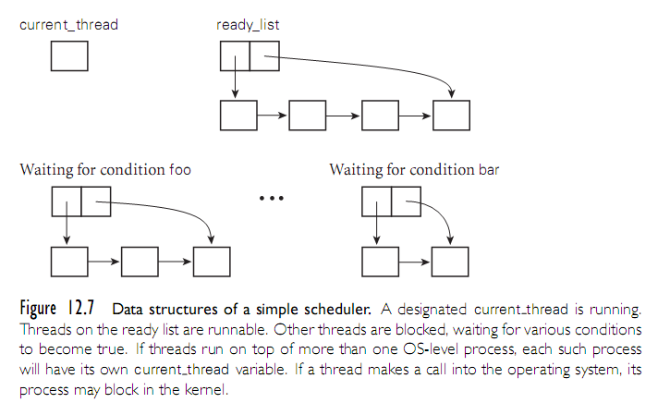
Concurrent Programming Fundamentals
Copyright © 2009 Elsevier

Slide 16
Concurrent Programming Fundamentals
Preemption
  Use timer interrupts (in OS) or signals (in library package) to trigger involuntary yields
  Requires that we protect the scheduler data structures:
      procedure yield:
        disable_signals
        enqueue(ready_list, current)
        Reschedule
        re-enable_signals
  Note that reschedule takes us to a different thread, possibly in code other than yield Invariant: EVERY CALL to reschedule must be made with signals disabled, and must re-enable them upon its return
      disable_signals
      if not <desired condition>
        sleep_on <condition queue>
      re-enable signals
Copyright © 2009 Elsevier

Slide 17
Concurrent Programming Fundamentals
Multiprocessors
  Disabling signals doesn't suffice:
      procedure yield:
      disable_signals
      acquire(scheduler_lock) // spin lock
      enqueue(ready_list, current)
      reschedule
      release(scheduler_lock)
      re-enable_signals
      disable_signals
      acquire(scheduler_lock) // spin lock
      if not <desired condition>
      sleep_on <condition queue>
      release(scheduler_lock)
      re-enable signals
Copyright © 2009 Elsevier

Slide 18
Implementing Synchronization
Condition synchronization with atomic reads and writes is easy
  You just cast each condition in the form of "location X contains value Y" and you keep reading X in a loop until you see what you want
Mutual exclution is harder
  Much early research was devoted to figuring out how to build it from simple atomic reads and writes
  Dekker is generally credited with finding the first correct solution for two processes in the early 1960s
  Dijkstra published a version that works for N processes in 1965
  Peterson published a much simpler two-process solution in 1981
Copyright © 2009 Elsevier

Slide 19
Implementing Synchronization
Repeatedly reading a shared location until it reaches a certain value is known as SPINNING or BUSY-WAITING
A busy-wait mutual exclusion mechanism is known as a SPIN LOCK
  The problem with spin locks is that they waste processor cycles
  Sychronization mechanisms are needed that interact with a thread/process scheduler to put a process to sleep and run something else instead of spinning
  Note, however, that spin locks are still valuable for certain things, and are widely used
    In particular, it is better to spin than to sleep when the expected
    spin time is less than the rescheduling overhead
Copyright © 2009 Elsevier

Slide 20
Implementing Synchronization
SEMAPHORES were the first proposed SCHEDULER-BASED synchronization mechanism, and remain widely used
CONDITIONAL CRITICAL REGIONS and MONITORS came later
Monitors have the highest-level semantics, but a few sticky semantic problem - they are also widely used
Synchronization in Java is sort of a hybrid of monitors and CCRs (Java 3 will have true monitors.)
Shared-memory synch in Ada 95 is yet another hybrid
Copyright © 2009 Elsevier

Slide 21
Implementing Synchronization
A semaphore is a special counter
It has an initial value and two operations, P and V, for changing that value
A semaphore keeps track of the difference between the number of P and V operations that have occurred
A P operation is delayed (the process is de-scheduled) until #P-#V <= C, the initial value of the semaphore
Copyright © 2009 Elsevier

Slide 22
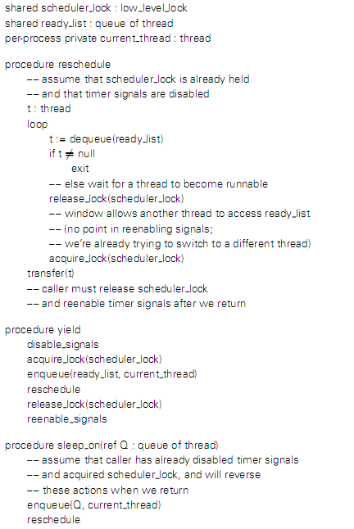
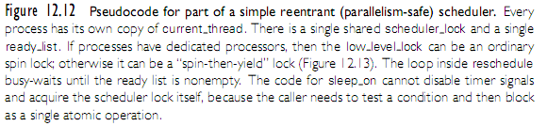
Implementing Synchronization
Note: a possible implementation is shown on the next slide
Copyright © 2009 Elsevier

Slide 23
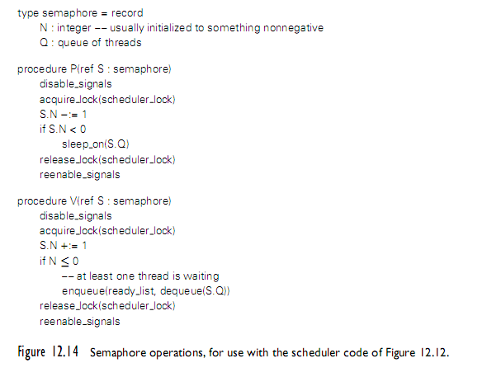
Implementing Synchronization
Copyright © 2009 Elsevier

Slide 24
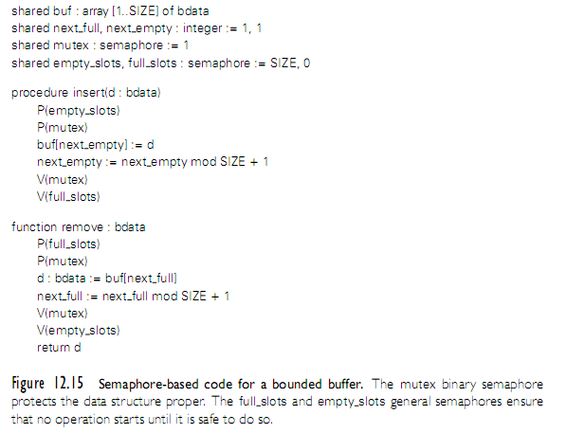
Implementing Synchronization
Copyright © 2009 Elsevier

Slide 25
Implementing Synchronization
It is generally assumed that semaphores are fair, in the sense that processes complete P operations in the same order they start them
Problems with semaphores
  They're pretty low-level.
    When using them for mutual exclusion, for example (the most common usage), it's easy to forget a P or a V, especially when they don't occur in strictly matched pairs (because you do a V inside an if statement, for example, as in the use of the spin lock in the implementation of P)
  Their use is scattered all over the place.
    If you want to change how processes synchronize access to a data structure, you have to find all the places in the code where they touch that structure, which is difficult and error-prone
Copyright © 2009 Elsevier

Slide 26
Language-Level Mechanisms
Monitors were an attempt to address the two weaknesses of semaphores listed above
They were suggested by Dijkstra, developed more thoroughly by Brinch Hansen, and formalized nicely by Hoare (a real cooperative effort!) in the early 1970s
Several parallel programming languages have incorporated monitors as their fundamental synchronization mechanism
  none, incorporates the precise semantics of Hoare's formalization
Copyright © 2009 Elsevier

Slide 27
Language-Level Mechanisms
A monitor is a shared object with operations, internal state, and a number of condition queues. Only one operation of a given monitor may be active at a given point in time
A process that calls a busy monitor is delayed until the monitor is free
  On behalf of its calling process, any operation may suspend itself by waiting on a condition
  An operation may also signal a condition, in which case one of the waiting processes is resumed, usually the one that waited first
Copyright © 2009 Elsevier

Slide 28
Language-Level Mechanisms
The precise semantics of mutual exclusion in monitors are the subject of considerable dispute. Hoare's original proposal remains the clearest and most carefully described
  It specifies two bookkeeping queues for each monitor: an entry queue, and an urgent queue
  When a process executes a signal operation from within a monitor, it waits in the monitor's urgent queue and the first process on the appropriate condition queue obtains control of the monitor
  When a process leaves a monitor it unblocks the first process on the urgent queue or, if the urgent queue is empty, it unblocks the first process on the entry queue instead
Copyright © 2009 Elsevier

Slide 29
Language-Level Mechanisms
Building a correct monitor requires that one think about the "monitor invariant“. The monitor invariant is a predicate that captures the notion "the state of the monitor is consistent."
  It needs to be true initially, and at monitor exit
  It also needs to be true at every wait statement
  In Hoare's formulation, needs to be true at every signal operation as well, since some other process may immediately run
Hoare's definition of monitors in terms of semaphores makes clear that semaphores can do anything monitors can
The inverse is also true; it is trivial to build a semaphores from monitors (Exercise)
Copyright © 2009 Elsevier

